Slide 1
Softening Methods
Lime-Soda Method
Zeolite Softener method
Ion Exchange Method

Slide 2
Lime-Soda Method
In this method, calculated quantity of Lime [Ca(OH)₂] and Soda [Na₂CO₃] mixture is added to hard water.
Precipitates of CaCO₃ and Mg(OH)₂ are formed due to reactions of hardness causing salts with lime and soda.
These precipitates gets settled down in the form of sludge.
This settling of precipitates is faster in hot lime soda method compared to cold Lime soda method.
Hence for quick settling of particles of CaCO₃ and Mg(OH)_{2,} coagulants such as Alum [Al₂(SO₄)₃], sodium meta aluminate [NaAlO₂], or FeSO₄ could be used in cold lime soda method.

Slide 3
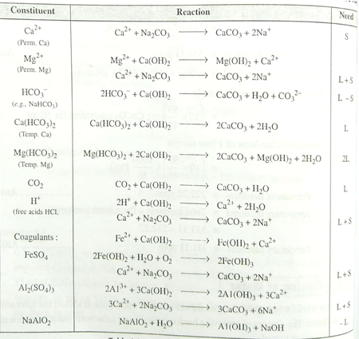

Slide 4
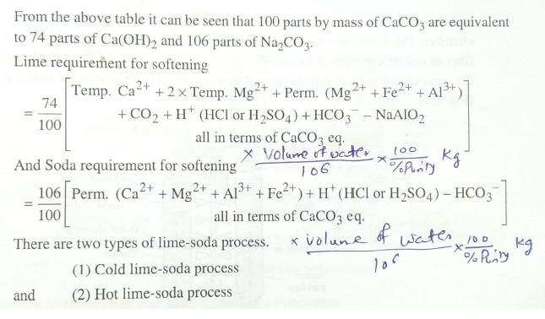

Slide 5
Cold Lime-Soda Method
In cold lime-soda method, hard water is treated with mixture of lime, soda and coagulants at room temperature about 25-30 ⁰C.
Inner cylindrical reaction tank equipped with stirrer, which ensures complete mixing of lime, soda and coagulants with hard water.
In outer conical sedimentation vessel, sludge settles down
Wood fiber filters ensures the complete removal of sludge particles from softened water.

Slide 6
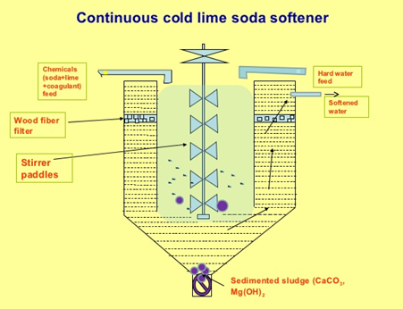
Cold Lime-Soda Method
Carried out at 25 ⁰C to 30 ⁰C
Coagulants required
Stirring is essential as the reaction is operated at low temperature
Slow process
Dissolved gases are not removed
Filtration is not easy
Residual hardness is 50-60 ppm
Low softening capacity

Slide 7
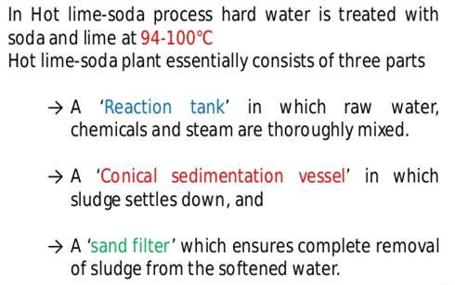
Hot Lime-Soda Method

Slide 8
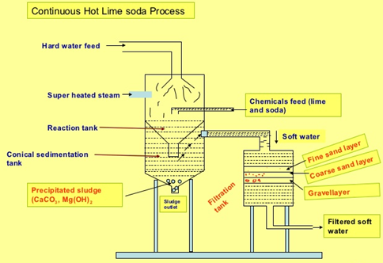
Hot Lime-Soda Method
Carried out at 95 ⁰C to 100 ⁰C
Coagulants are not required
Stirring is not essential as the reaction is operated at high temperature
Fast process
Dissolved gases gets removed due to high temperature
Filtration is easy, hence sand filter is sufficient
Residual hardness is 15-30 ppm
High softening capacity

Slide 9
Advantages of hot lime-soda method over cold lime-soda method
Economical process
pH value of softened water is high (Decrease corrosion)
Alkaline nature of treated water reduces pathogens, bacteria in water
Fe (II) and Mn (II) can also be removed to certain extent

Slide 10
Disadvantages of Lime-soda method
Softened water is 50 ppm hardness in cold lime-soda method and 15-30 ppm hardness in hot lime-soda method.
Such water can not be used in high pressure boilers
Disposal of large quantity of sludge is a big problem

Slide 11
Zeolite softener method
Sodium-Zeolites which are hydrated sodium alumino silicates, capable of exchanging their sodium ions with hardness producing ions are used.
Chemically sodium zeolites are Na₂O.Al₂O₃.xSiO₂.yH₂O
(Where, x= 2-10 & y= 2-6).
Principle: hard water passed over zeolite, it exchanges its own sodium ions with hardness causing ions.
2Na⁺ ions are generally exchanged with each bivalent hardness producing ions.

Slide 12
Process
For softening, hard water is passed over zeolite bed at specific rate
The hardness causing ions will be retained on zeolite and they are exchanged with equivalent sodium ions
After certain usage zeolite gets exhausted as all the sodium ions got exchanged
Such exhausted zeolite is regenerated by passing 10 % brine solution over it
This regenerates the zeolite by replacing hardness causing ions with Na⁺ ions to become Na-zeolite
Hence softening and regeneration are exactly opposite reactions

Slide 13
Reactions
Softening:
For softening of hard water, it is passed over sodium zeolite bed. Exchange of hardness causing ions takes place with sodium ions present on zeolite. The following reactions takes place.
CaCl₂ + Na₂Ze CaZe + 2NaCl
MgSO₄ + Na₂Ze MgZe + Na₂SO₄
Regeneration:
For regeneration of exhausted zeolite, 10 % brine solution is passed over used zeolite.
CaZe + 2NaCl CaCl₂ + Na₂Ze
MgZe + 2NaCl MgCl₂ + Na₂Ze

Slide 14
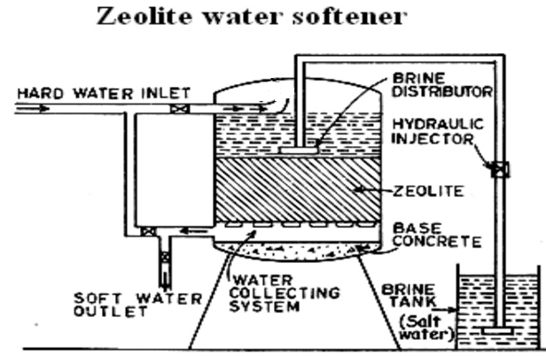

Slide 15
Advantages
Water obtained after treatment is about 10 ppm hardness
No sludge formation is taking place
Equipment is compact and easy in operation
Equipment occupies less space and low in maintenance

Slide 16
Limitations and Disadvantages of Zeolite softener method
Limitations
Suspended impurities blocks the pores of zeolite
Colored ions such as Fe³⁺ and Mn²⁺ forms strong bonds with zeolite hence can not be removed while regeneration from zeolite
Mineral acids can destroy zeolite
Disadvantages
The treated water is high in sodium salts
Only cations could be removed leaving behind anions in water

Slide 17
Ion Exchange softener method (De-mineralization process)
Ion exchange resins are insoluble, cross-linked, long chain organic polymers with micro-porous structure. The functional groups attached to the chains are responsible for ion exchanging property.
Cation Exchanger resins (RH⁺) :
Resins containing acidic functional groups (-COOH, -SO₃H etc.) are capable of exchanging their H⁺ ions with other cations in hard water.
Anion Exchanger resins (ROH⁻) :
Resins containing basic functional groups (-NH₂-OH, =NH-OH, -NMe₂-OH etc.) are capable of exchanging their OH⁻ with other anions in hard water.

Slide 18
Process - Softening
For softening, hard water is first passed over cations exchanger resin column at specific rate, which removes cations like Ca²⁺, Mg²⁺ etc. from hard water.
The hardness causing ions will be retained on cation exchanger resin and they are exchanged with equivalent amount of H⁺ ions
Further, the softened water from cation exchanger column is passed through anion exchanger column, which removes anions like, SO₄²⁻, Cl⁻, CO₃²⁻ etc. with equivalent amount of OH⁻ ions from the resin.
H⁺ and OH⁻ ions from resin columns combines to form water.
Softening
2 RH⁺ + CaCl₂ R₂Ca²⁺ + 2HCl
2 RH⁺ + MgSO₄ R₂Mg²⁺ + H₂SO₄
2 ROH⁻ + 2Cl⁻ R₂Cl⁻ + 2 OH⁻
2 ROH⁻ + SO₄²⁻ R₂SO₄²⁻ + 2 OH⁻

Slide 19
Process - Regeneration
After certain usage both cation and anion exchanger resins gets exhausted and they can not exchange any more cations or anions.
Exhausted cation exchanger resin is regenerated by passing dil. HCl solution
Exhausted anion exchanger resin is regenerated by passing dil. NaOH solution
This regenerates both the resins making the method reusable.
Regeneration
R₂Ca²⁺ + 2HCl 2 RH⁺ + CaCl₂
R₂Mg²⁺ + H₂SO₄ 2 RH⁺ + MgSO₄
R₂Cl⁻ + 2 NaOH 2 ROH⁻ + 2NaCl
R₂SO₄²⁻ + 2 NaOH 2 ROH⁻ + Na₂SO₄

Slide 20
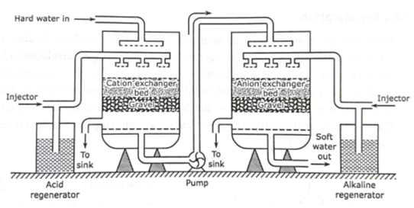
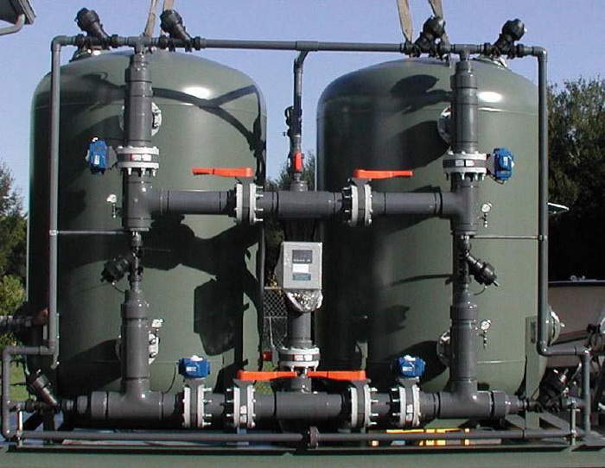
Ion Exchange Softener
(Commercial plant)

Slide 21
Advantages
The process can be used for highly acidic or alkaline water.
It produces water of very low hardness (less than 2 ppm).
Softened water can be used in steam generation boiler.
Disadvantages
The equipment is costly and expensive resins are required.
Turbid water could decrease the efficiency of the method. Hence turbidity need to be removed first by coagulation and then water could be passed over the resin.

Slide 22
BOD (Biological Oxygen Demand)
It is a measure of amount of oxygen required for the biological oxidation of organic matter under aerobic conditions at 20⁰ C for a period of 5 days.
Organic matter + O₂ Micro-organisms CO₂ + H₂O
BOD is the direct measurement of extent of pollution in waste water & industrial effluent.
Only applicable for bio-degradable pollutants.
Higher the BOD, higher will be the level of pollutants in water.
Drinking water should have BOD less than 1 ppm.

Slide 23
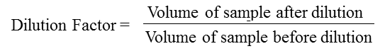
Principle
Dissolved oxygen content of diluted waste-water is determined at the beginning of the reaction by Winkler’s method or by DO meter.
Same sample of water is kept for incubation in the presence of micro-organisms for 5 days at 20⁰ C and decrease in the dissolved oxygen content is determined by Winkler’s method or by DO meter.
BOD = [(DO)_{Blank} – (DO)_{Incubated} ] X Dilution Factor
(DO)_{Blank} = Dissolved oxygen of diluted sample in the beginning of the reaction
(DO)_{Incubated} = Dissolved oxygen of diluted sample after incubation for 5 days at 20 ⁰ C.

Slide 24
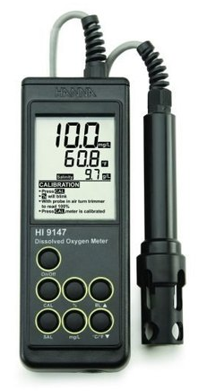
BOD Meter

Slide 25
Significance of BOD
BOD gives the extent of bio-degradable pollutants in wastewater sample
It also helps in pollution control in water
It also express self-purification capacity of any water body.

Slide 26
COD (Chemical Oxygen Demand)
It is a measure of amount of oxygen required for the chemical oxidation of organic matter when refluxed in acidified potassium dichromate in the presence of Ag₂SO₄ or HgSO₄ catalyst for 3 hours.
CxHyOz + (X + Y/4 – Z/2) O₂ X CO₂ + (Y/2) H₂O
(Organic matter) [O]
COD is the direct measurement of extent of pollution in waste water & industrial effluent.
Applicable for both bio-degradable and non bio-degradable pollutants.
Higher the COD, higher will be the level of pollutants in water.
Drinking water should have COD less than 1 ppm.

Slide 27
Principle
A known volume of waste water sample (say 250 ml) is refluxed with a known excess of standard potassium dichromate (1 N) and dilute/conc. sulfuric acid mixture in the presence of silver sulphate catalyst for about 3 hours.
This oxidases organic matter to CO₂, NH₃ and H₂O.
The unreacted potassium dichromate is titrated against Ferrous ammonium sulphate (Mohr’s salt) with ferroin indicator till blue colour changes to wine red, the reading is (Vt).
This gives the amount of potassium dichromate consumed (in terms of equivalent oxygen) required for degradation of organic pollutants.
Blank titration is performed initially with known volume of waste water sample and added acidified standard potassium dichromate titrated against Ferrous ammonium sulphate (Mohr’s salt) with ferroin indicator till blue colour changes to wine red, the reading is (Vb) (zero minute reading)

Slide 29
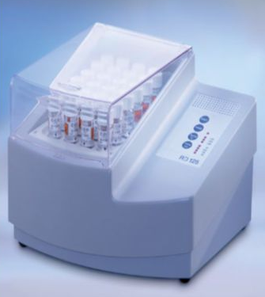
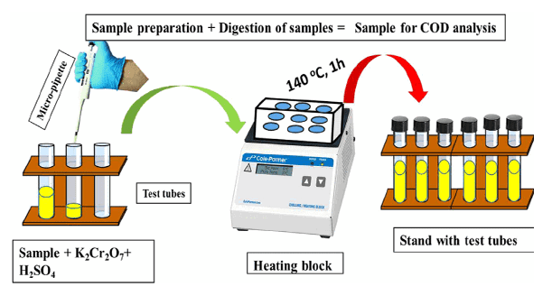
COD Meter

Slide 30
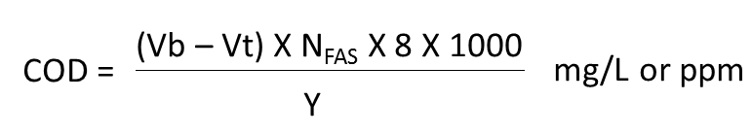
Principle
Vb = Volume of FAS required for blank titration (Zero time)
Vt = Volume of FAS required for reaction mass after time (t)
Y = Volume of waste water sample taken

Slide 31
Significance of COD
COD gives the extent of pollution caused by bio-degradable and non bio-degradable pollutants in wastewater sample
It helps in rapid determination of pollutants level in water compared to BOD
It is taken as a basis for calculation of efficiency and designing of water treatment plants.

Slide 32
Comparison between BOD and COD
BOD | COD
It measures oxygen demand of bio-degradable organic pollutants only | It measures oxygen demand of bio-degradable and non biodegradable organic pollutants
Less stable measurement technique as micro-organisms are susceptible to variables such as pH and temperature | More stable measurement technique as no micro-organisms are used and potassium dichromate oxidizes any type of organic pollutants in water
Slow process, takes 5 days | Fast process , takes 3 hours
BOD values are generally less than COD values | COD values are generally greater than BOD values

Slide 33
Formulae
1. BOD = [(DO)_{Blank} – (DO)_{Incubated} ] x Dilution Factor
(DO)_{Blank} = Dissolved oxygen of diluted sample in the beginning of the reaction
(DO)_{Incubated} = Dissolved oxygen of diluted sample after incubation for 5 days at 20 ⁰ C.
2.
Vb = Volume of FAS required for blank titration (Zero time)
Vt = Volume of FAS required for reaction mass after time (t)
Y = Volume of waste water sample taken

Slide 34
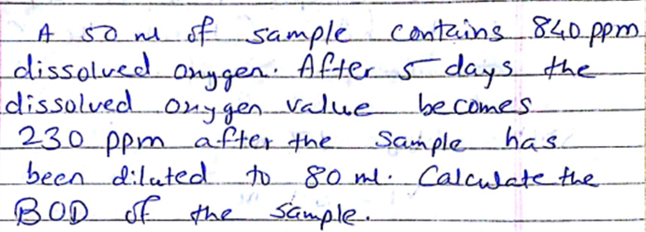

Slide 35
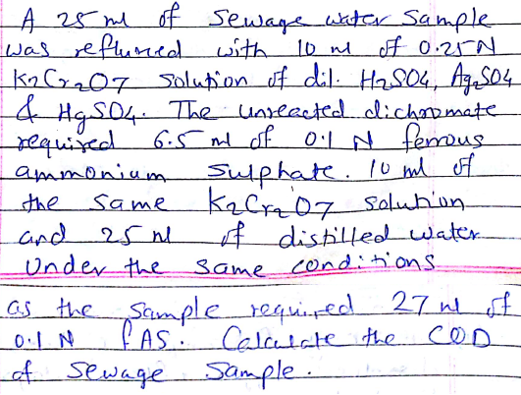

Slide 36
Activated Sludge Method (Sewage Treatment)
Sewage includes household waste, ground waste, street waste and some industrial waste water.
It is necessary to treat Sewage waste-water to reduce its pollutant level before releasing it into any water bodies.
This is because to prevent further pollution of water bodies and to protect aquatic life.
This method is an aerobic treatment of sewage water or industrial waste water, before releasing it into lake, river or sea.

Slide 37
Activated Sludge Method
This is a step-wise process involves following steps:
Preliminary Treatment
Primary Treatment
Secondary (Biological) Treatment
(Activated Sludge / Trickling Filters)
Tertiary Treatment

Slide 38
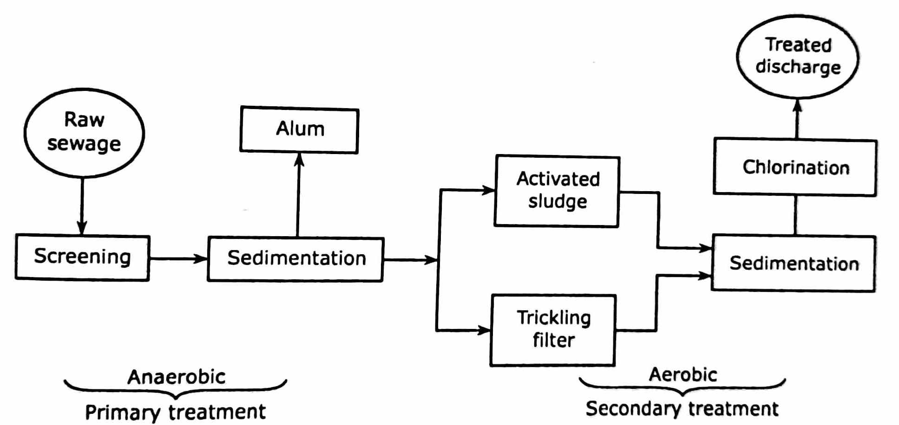

Slide 39
Preliminary Treatment
The principle behind this step is to remove large floating and suspended solid matter like plastic, rubber, clothes, grit, oil and greases etc.
For the removal of such large size matter the sewage water is allowed to pass through bar screens and mesh screens

Slide 40
Primary Treatment
This step is the sedimentation step, in which with the help of flocculants (Alum, lime), small size suspended matter is allowed to settle down.
Small particles (colloidal size) are converted / coagulated into big particles and allowed to settle

Slide 41
Secondary (Biological) Treatment
This step involves biological oxidation, filtration and activated sludge method.
Sewage water gets filtered through specially design sprinkling filters, which ensures aerobic conditions throughout.
Trickling filters are used for the biological oxidation of sewage.
Sewage is delivered to this filters through rotating distributor

Slide 42
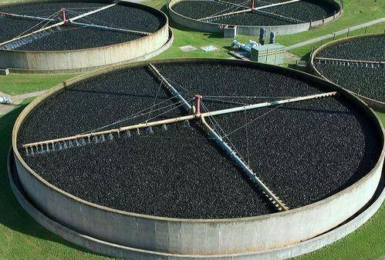
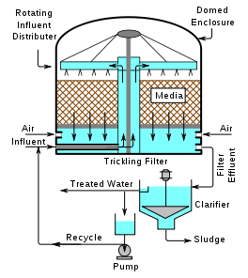
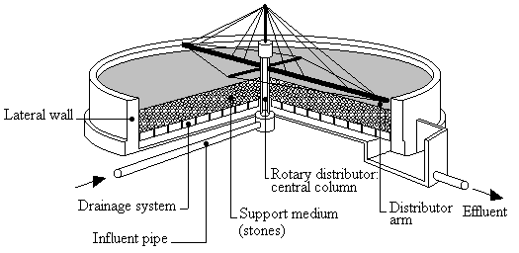

Slide 43
(Activated Sludge / Trickling Filters)
Trickled sewage water starts percolating downwards, the aerobic bacteria grows on the surface, this carries biological oxidation.
The sludge from the above oxidation process is known as activated sludge.
This activated sludge can be used multiple times for further sewage treatments.

Slide 44
Tertiary Treatment
This step is used to decrease the load of nitrogen, phosphorous and micro-organisms from the treated sewage water.
Precipitation: Treatment of water with lime which reacts with phosphorus to form calcium phosphate
Nitrogen stripping: It is carried out to remove ammonia gas
Chlorination: The water is treated with hypo-chlorus acid or ClO₂ or bleaching powder in order to remove micro-organisms in the treated water
Finally water can be discharged into river, lake or sea

Slide 45
Waste Water Treatment Plant
General method-
https://www.youtube.com/watch?v=ciPFC3Y2rkg
NYC Plant-
https://www.youtube.com/watch?v=FvPakzqM3h8
Kerala Plant-
https://www.youtube.com/watch?v=1e85WmSODmk

